Slide 1

BSSE -Software Quality Engineering Week-10 Lecture19-20 Semester 6- Fall 2020

Slide 2
System testing, Introduction to sub-system testing, From functional to system aspects of testing, System testing, Introduction to system testing, Scenarios development, System testing, Use-cases for testing, Specification-based testing

Slide 3
What is System Testing?
SYSTEM TESTING is a level of testing that validates the complete and fully integrated software product.
The purpose of a system test is to evaluate the end-to-end system specifications.
Usually, the software is only one element of a larger computer-based system.
Ultimately, the software is interfaced with other software/hardware systems.
System Testing is actually a series of different tests whose sole purpose is to exercise the full computer-based system.

Slide 4
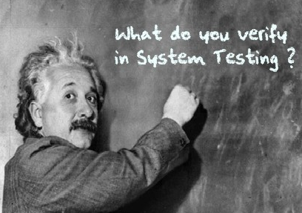
What do you verify in System Testing?
System Testing involves testing the software code.
Testing the fully integrated applications including external peripherals in order to check how components interact with one another and with the system as a whole. This is also called End to End testing scenario.

Slide 5
Verify thorough testing of every input in the application to check for desired outputs.
Testing of the user's experience with the application.
That is a very basic description of what is involved in system testing. You need to build detailed test cases and test suites that test each aspect of the application as seen from the outside without looking at the actual source code.

Slide 6
Different Types of System Testing
Usability Testing- mainly focuses on the user's ease to use the application, flexibility in handling controls and ability of the system to meet its objectives
Load Testing- is necessary to know that a software solution will perform under real-life loads.
Regression Testing- involves testing done to make sure none of the changes made over the course of the development process have caused new bugs. It also makes sure no old bugs appear from the addition of new software modules over time.

Slide 7
Recovery testing - is done to demonstrate a software solution is reliable, trustworthy and can successfully recoup from possible crashes.
Migration testing- is done to ensure that the software can be moved from older system infrastructures to current system infrastructures without any issues.
Functional Testing - Also known as functional completeness testing, Functional Testing involves trying to think of any possible missing functions. Testers might make a list of additional functionalities that a product could have to improve it during functional testing.
Hardware/Software Testing - IBM refers to Hardware/Software testing as "HW/SW Testing". This is when the tester focuses his/her attention on the interactions between the hardware and software during system testing.

Slide 8
What Types of System Testing Should Testers Use?
There are over 50 different types of system testing. The specific types used by a tester depend on several variables. Those variables include:
Who the tester works for - This is a major factor in determining the types of system testing a tester will use. Methods used by large companies are different than that used by medium and small companies.
Time available for testing - Ultimately, all 50 testing types could be used. Time is often what limits us to using only the types that are most relevant for the software project.
Resources available to the tester - Of course some testers will not have the necessary resources to conduct a testing type. For example, if you are a tester working for a large software development firm, you are likely to have expensive automated testing software not available to others.

Slide 9
Software Tester's Education- There is a certain learning curve for each type of software testing available. To use some of the software involved, a tester has to learn how to use it.
Testing Budget - Money becomes a factor not just for smaller companies and individual software developers but large companies as well.

Slide 10
System Testing Process: System Testing is performed in the following steps:
Test Environment Setup: Create testing environment for the better quality testing.
Create Test Case: Generate test case for the testing process.
Create Test Data: Generate the data that is to be tested.
Execute Test Case: After the generation of the test case and the test data, test cases are executed.
Defect Reporting: Defects in the system are detected.
Regression Testing: It is carried out to test the side effects of the testing process.
Log Defects: Defects are fixed in this step.
Retest: If the test is not successful then again test is performed.

Slide 11
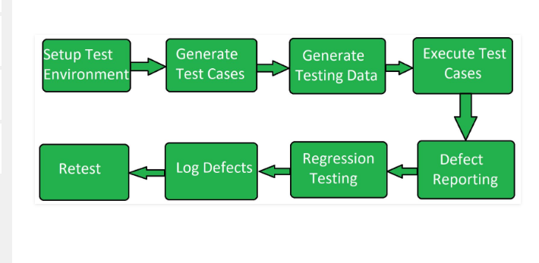

Slide 12
What is Specification Based Testing?
Specification Based Testing Technique is also known as Behavior Based Testing and Black Box Testing techniques because in this testers view the software as a black-box.
As they have no knowledge of how the system or component is structured inside the box. In essence, the tester is only concentrating on what the software does, not how it does it.
Specification Based Test Design Technique uses the specification of the program as the point of reference for test data selection and adequacy. A specification can be anything like a written document, collection of use cases, a set of models or a prototype.

Slide 13
Types of specification based testing techniques
Equivalence partitioning: software testing technique that divides the input data of a software unit into partitions of equivalent data from which test cases can be derived. learn more
Boundary value analysis: software testing technique in which tests are designed to include representatives of boundary values in a range.
Decision tables: software testing technique in which tests are more focused on business logic or business rules. a decision table is a good way to deal with combinations of inputs.
State transitioning: software testing technique which is used when the system is defined in terms of a finite number of states and the transitions between the states is governed by the rules of the system.

Slide 14
Decision Table
A decision table is a good way to deal with different combination inputs with their associated outputs. It is a black box test design technique to determine the test scenarios for complex business logic. In this article, know more about how the decision table in software testing helps in test design technique in the following sequence:

Slide 15
What is Decision Table in Software Testing?
The decision table is a software testing technique which is used for testing the system behavior for different input combinations. This is a systematic approach where the different input combinations and their corresponding system behavior are captured in a tabular form.
This table helps you deal with different combination inputs with their associated outputs. Also, it is known as the cause-effect table because of an associated logical diagramming technique called cause-effect graphing that is basically used to derive the decision table

Slide 16
Why is Decision Table Important?
A decision table is an outstanding technique used for testing and requirements management. Some of the reasons why the decision table is important include:
Decision tables are very much helpful in test design technique.
It helps testers to search the effects of combinations of different inputs and other software states that implement business rules.
It provides a regular way of stating complex business rules which benefits the developers as well as the testers.
It assists in the development process with the developer to do a better job. Testing with all combination might be impractical.
It the most preferable choice for testing and requirements management.
It is a structured exercise to prepare requirements when dealing with complex business rules.
It is also used in model complicated logic.

Slide 17
Advantages of Decision Table in Software Testing
There are different advantages of using the decision table in software testing such as:
Any complex business flow can be easily converted into the test scenarios & test cases using this technique.
Decision tables work iteratively. Therefore, the table created at the first iteration is used as the input table for the next tables. The iteration is done only if the initial table is not satisfactory.
Simple to understand and everyone can use this method to design the test scenarios & test cases.
It provides complete coverage of test cases which help to reduce the rework on writing test scenarios & test cases.
These tables guarantee that we consider every possible combination of condition values. This is known as its completeness property.

Slide 18
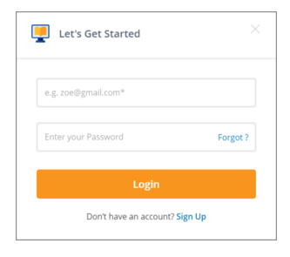
Way to use Decision Table: Example
A Decision Table is a tabular representation of inputs versus rules, cases or test conditions. Let’s take an example and see how to create a decision table for a login screen:

Slide 19
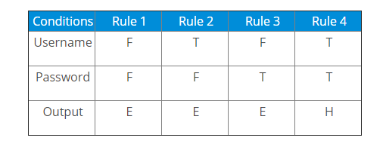
The condition states that if the user provides the correct username and password the user will be redirected to the homepage. If any of the input is wrong, an error message will be displayed.
In the above example,
T – Correct username/password
F – Wrong username/password
E – Error message is displayed
H – Home screen is displayed

Slide 20
Now let’s understand the interpretation of the above cases:
Case 1 – Username and password both were wrong. The user is shown an error message.
Case 2 – Username was correct, but the password was wrong. The user is shown an error message.
Case 3 – Username was wrong, but the password was correct. The user is shown an error message.
Case 4 – Username and password both were correct, and the user is navigated to the homepage.
So, this was an example of building a decision table in software testing.

Slide 21
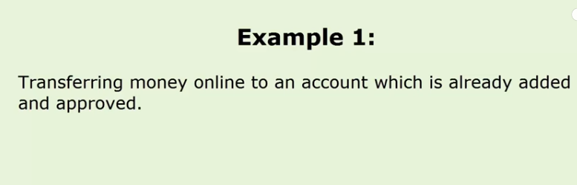
ONLINE MONEY TRANSFER

Slide 22
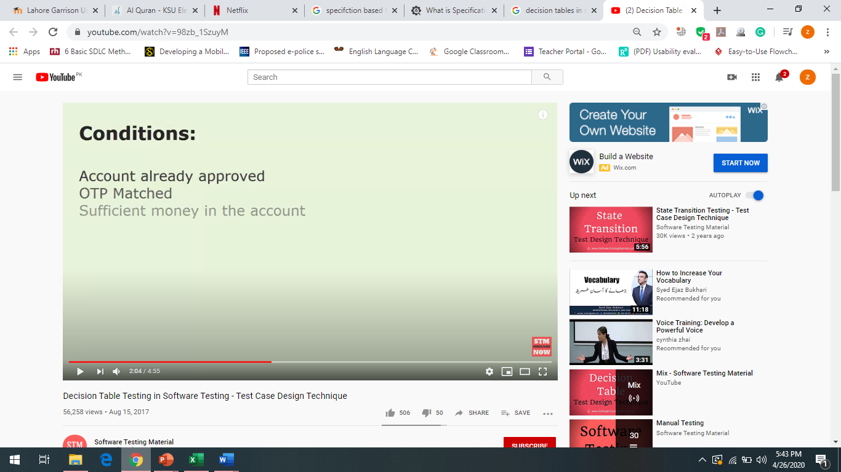
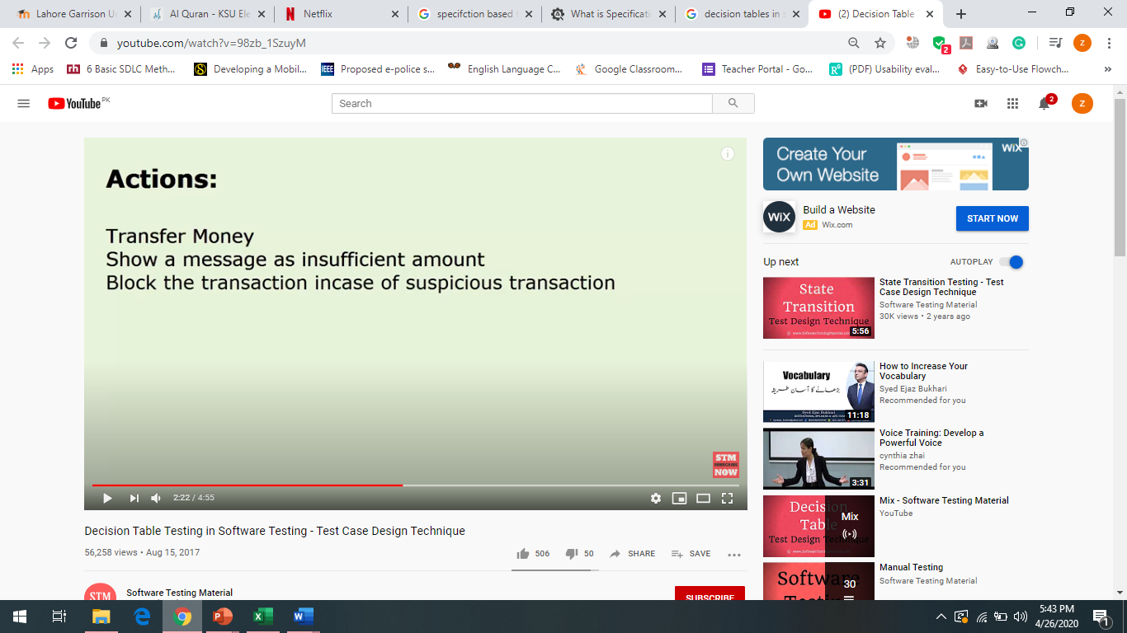

Slide 23
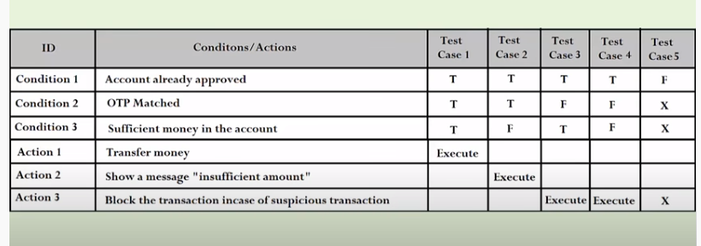
DECISION TABLE

Slide 24


Slide 25
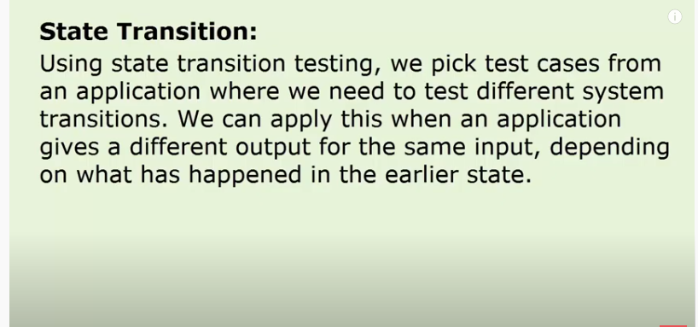

Slide 26
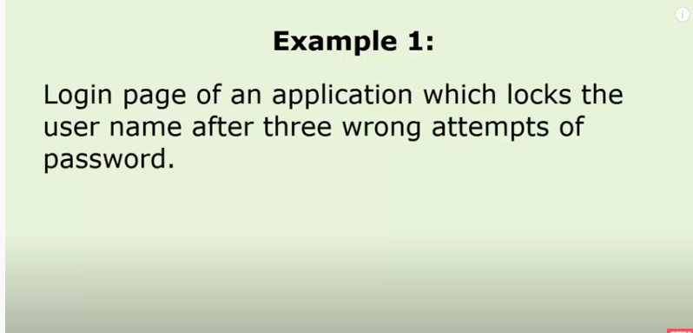

Slide 27
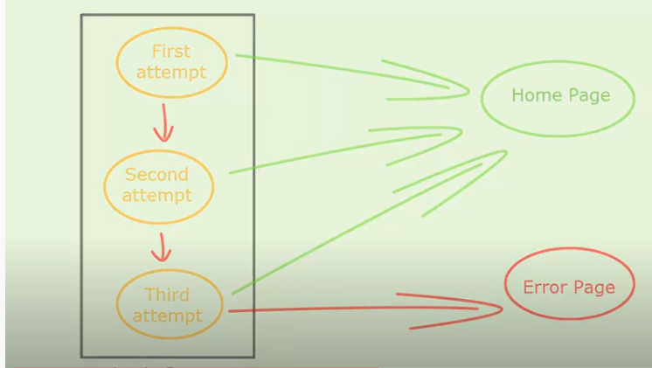
LOGIN

Slide 28
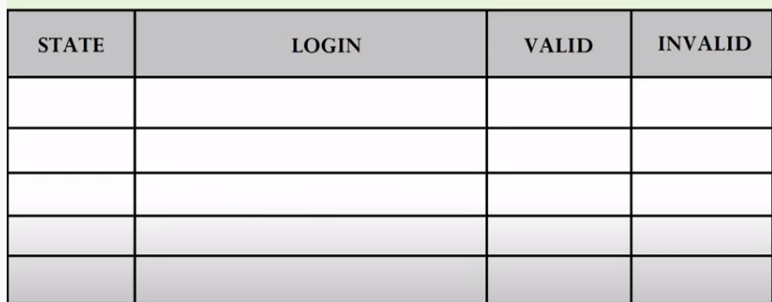

Slide 29
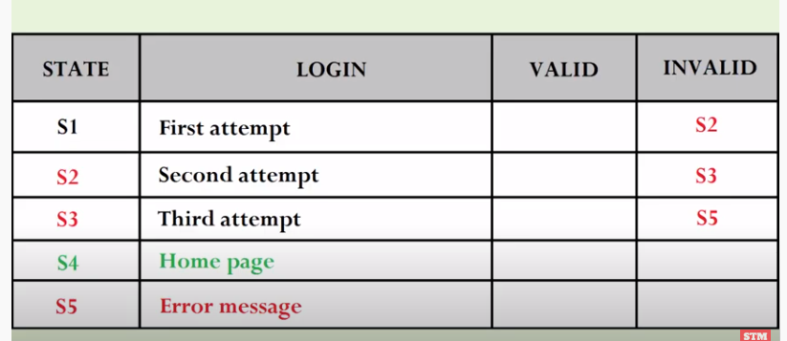

Slide 30
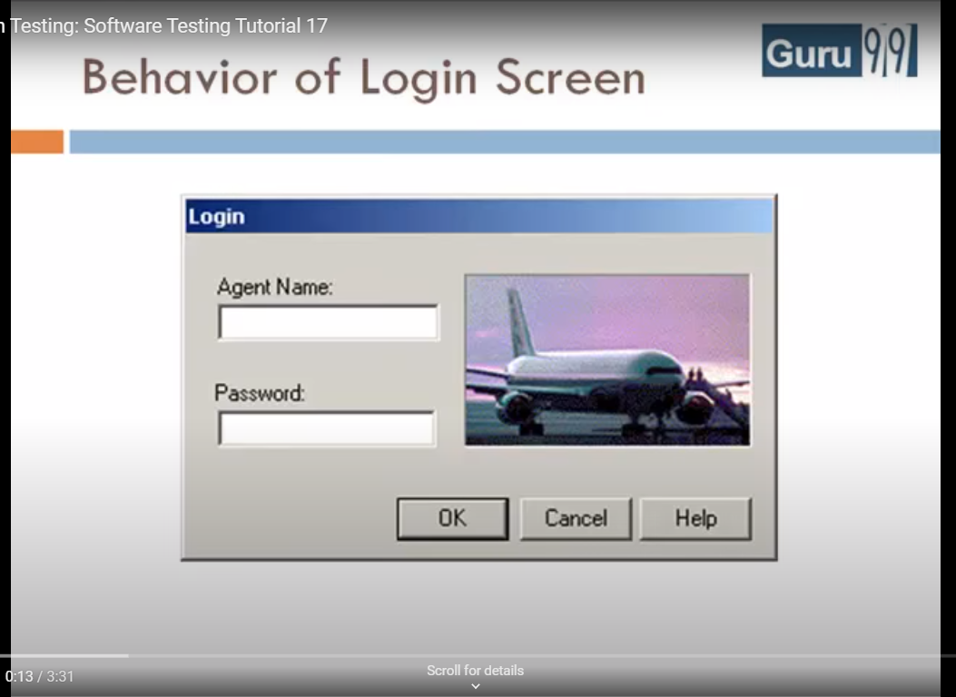
EXAMPLE

Slide 31
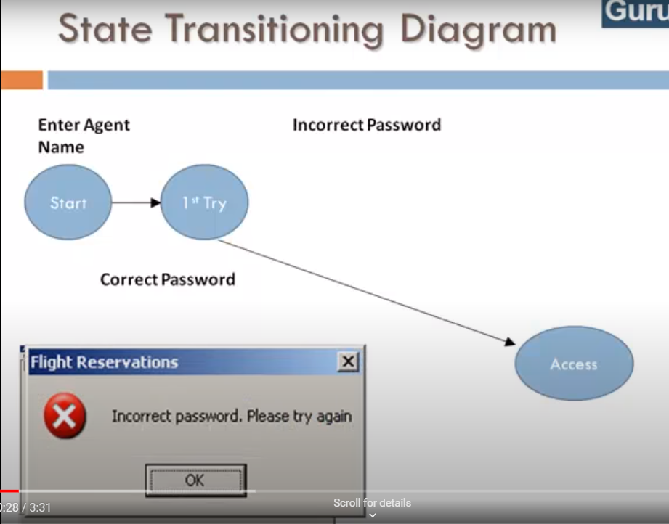

Slide 32
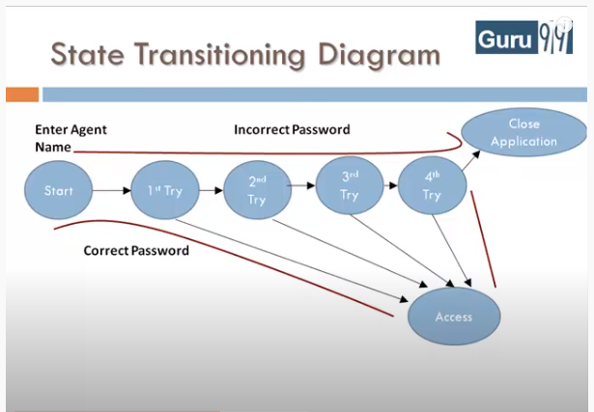

Slide 33
